Slide 1
Kinesis-Data Streaming-Data Processing
Kinesis,firehouse,s3, lambda function.

Slide 2
Architecture: S3 → Lambda → Kinesis → Firehose → S3 (Final Destination)
Files arrive in S3
S3 triggers a Lambda function
Lambda sends processed data to Kinesis Data Stream
Kinesis Data Stream sends data to Kinesis Firehose
Firehose delivers the final data to S3

Slide 3
Step-by-Step Setup
1. Create S3 Bucket (Source Bucket)
Go to Amazon S3
Create a bucket (e.g., source: input-data-kinesis-bucket, destination bucket : output-realtime-data)
This bucket will store incoming files/events.

Slide 4
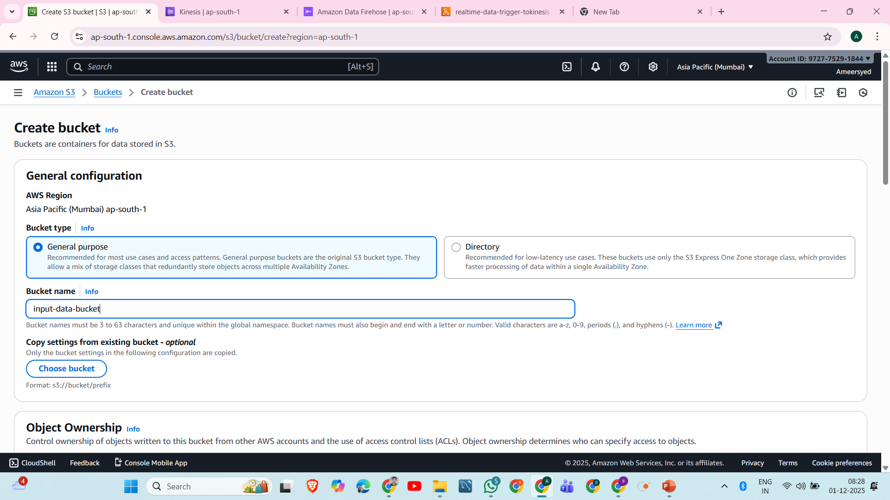

Slide 5
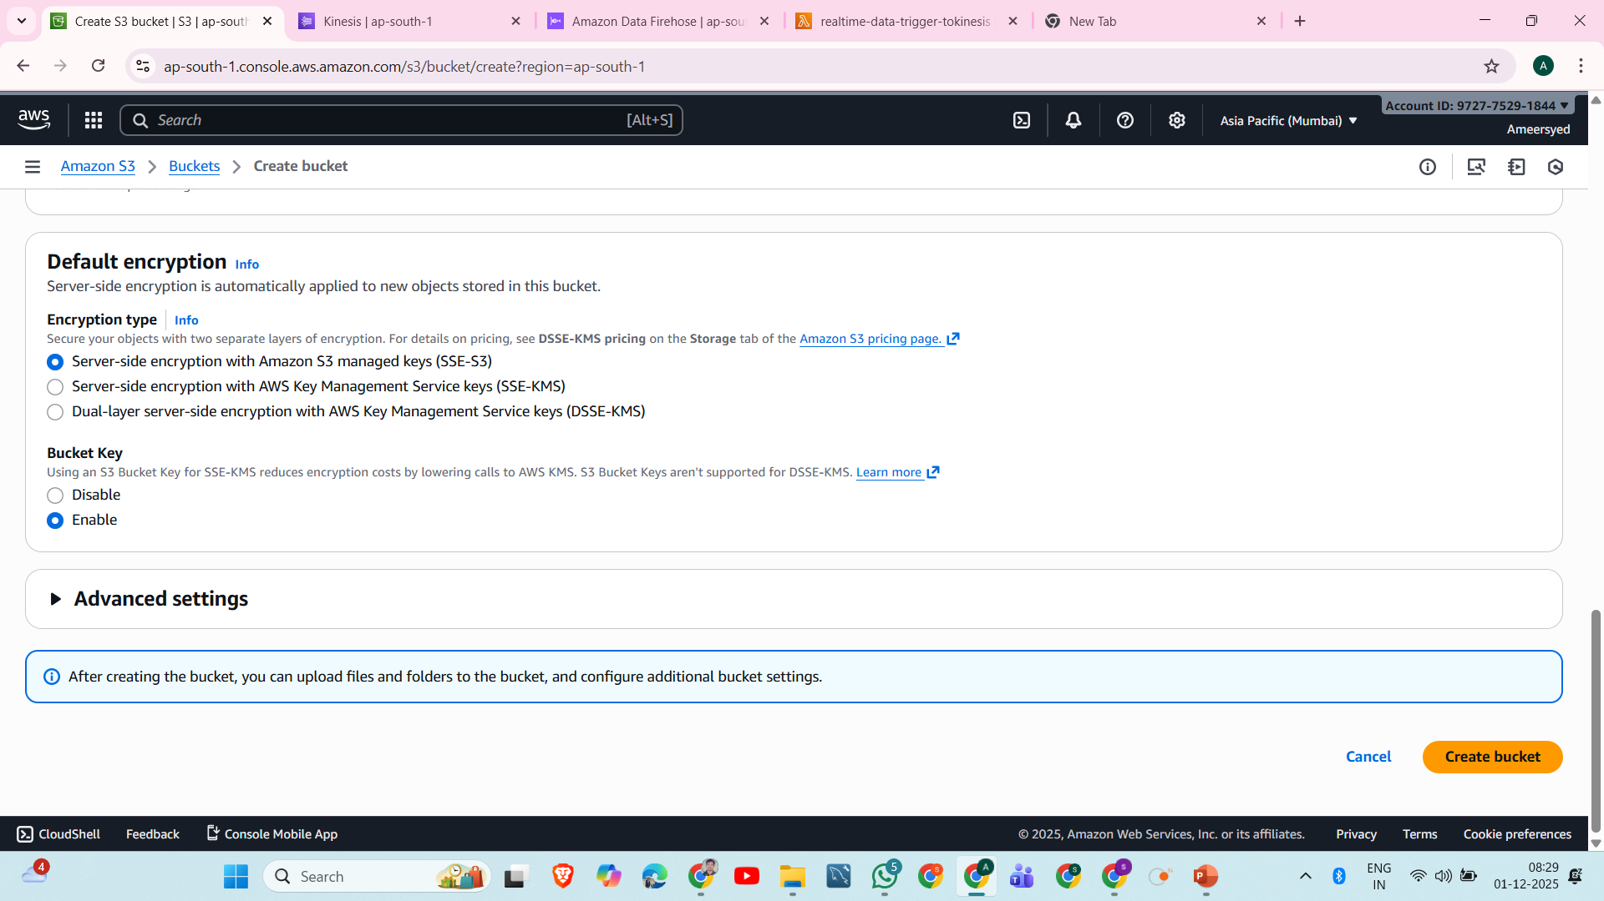

Slide 6
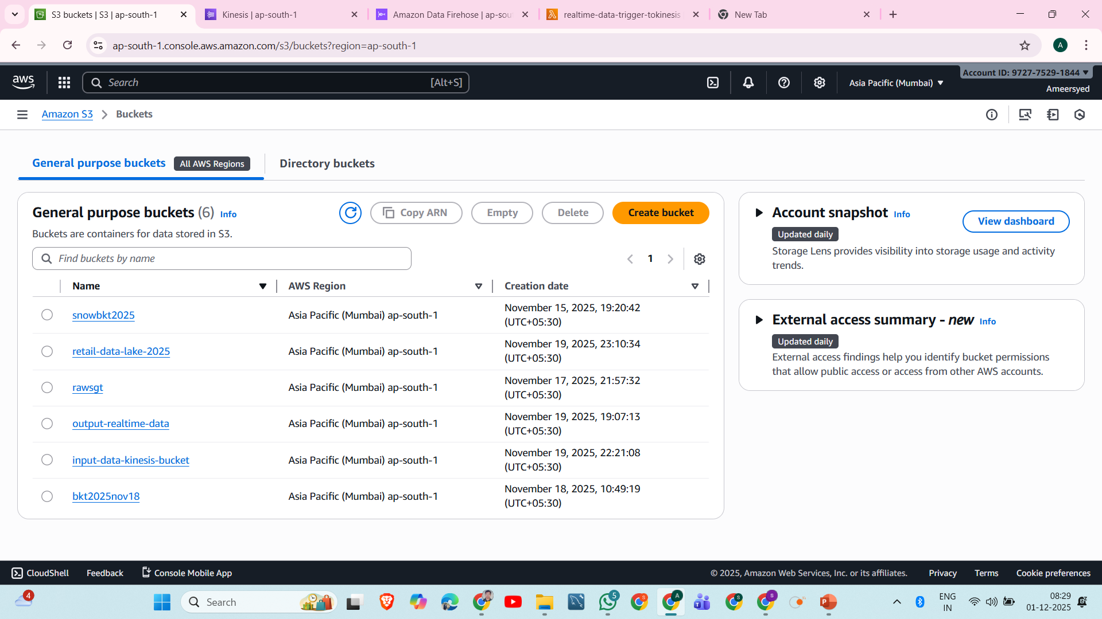

Slide 7
2. Create a Kinesis Data Stream
Purpose:
Receives events from Lambda
Acts as real-time streaming buffer
Steps:
Go to Kinesis → Data Streams
Click Create Data Stream
Give name: transaction-realtime-data
Select shards based on throughput

Slide 8
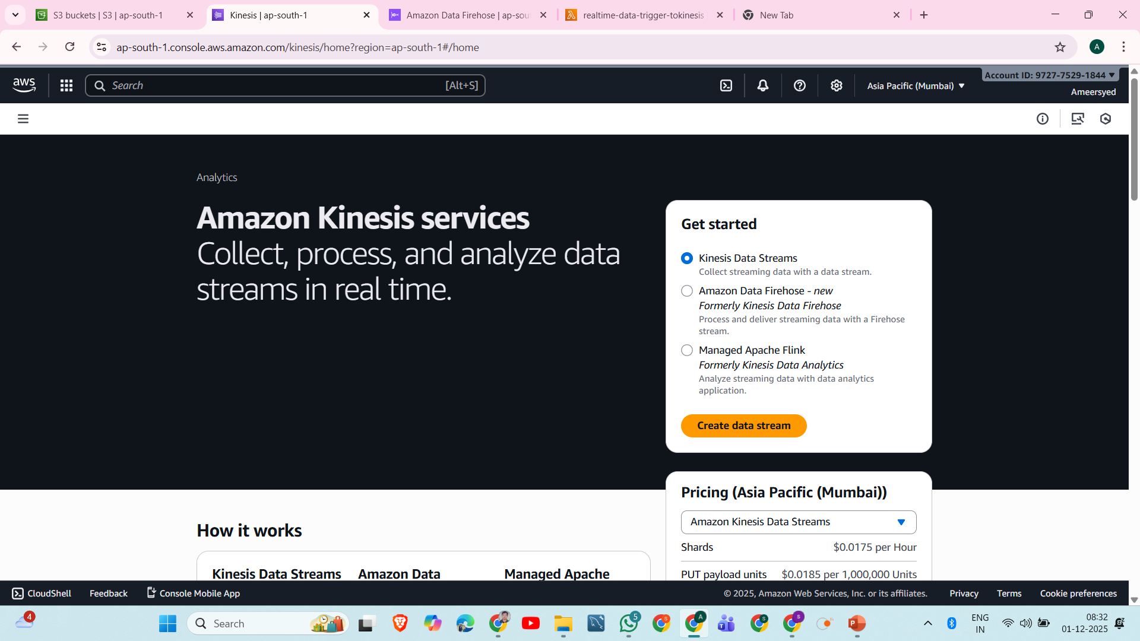

Slide 9
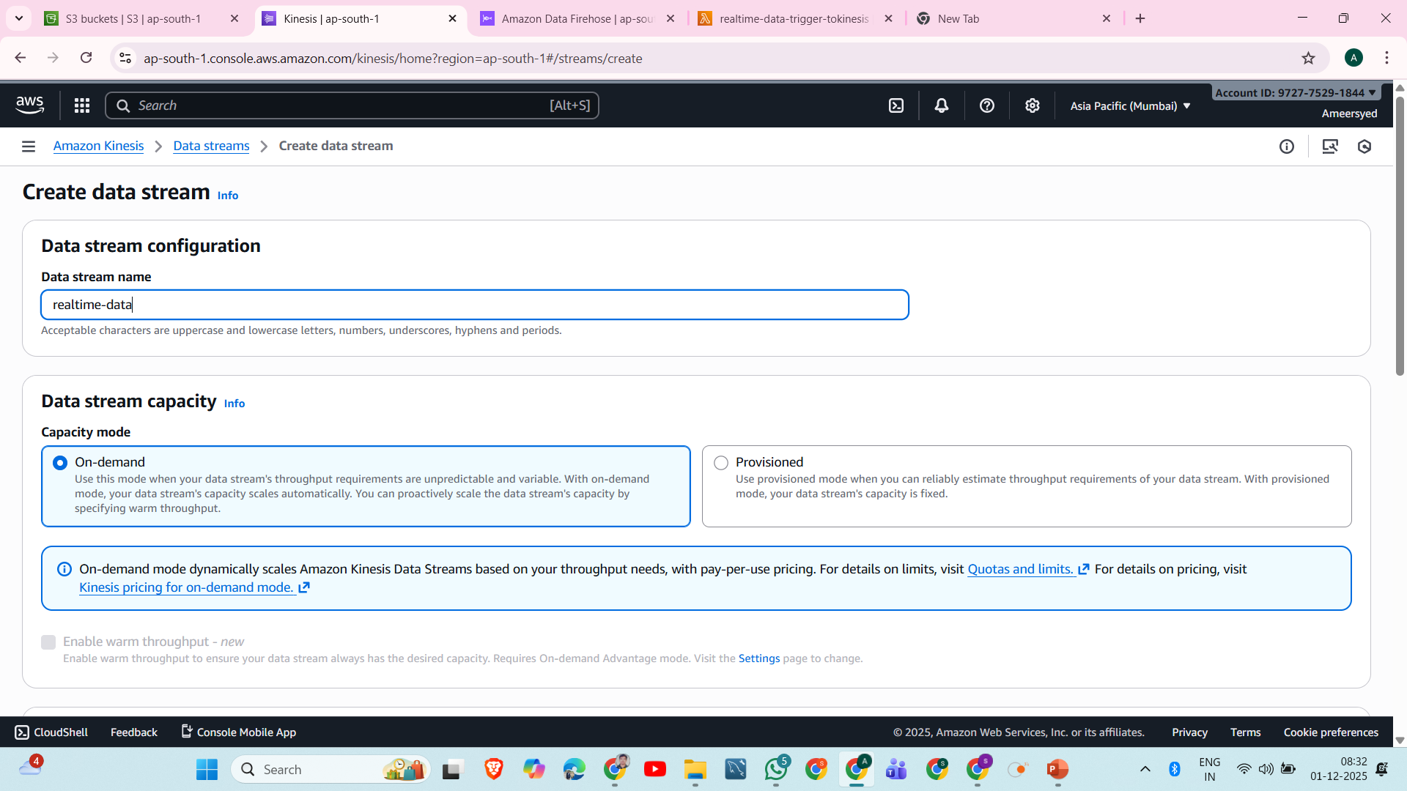

Slide 10
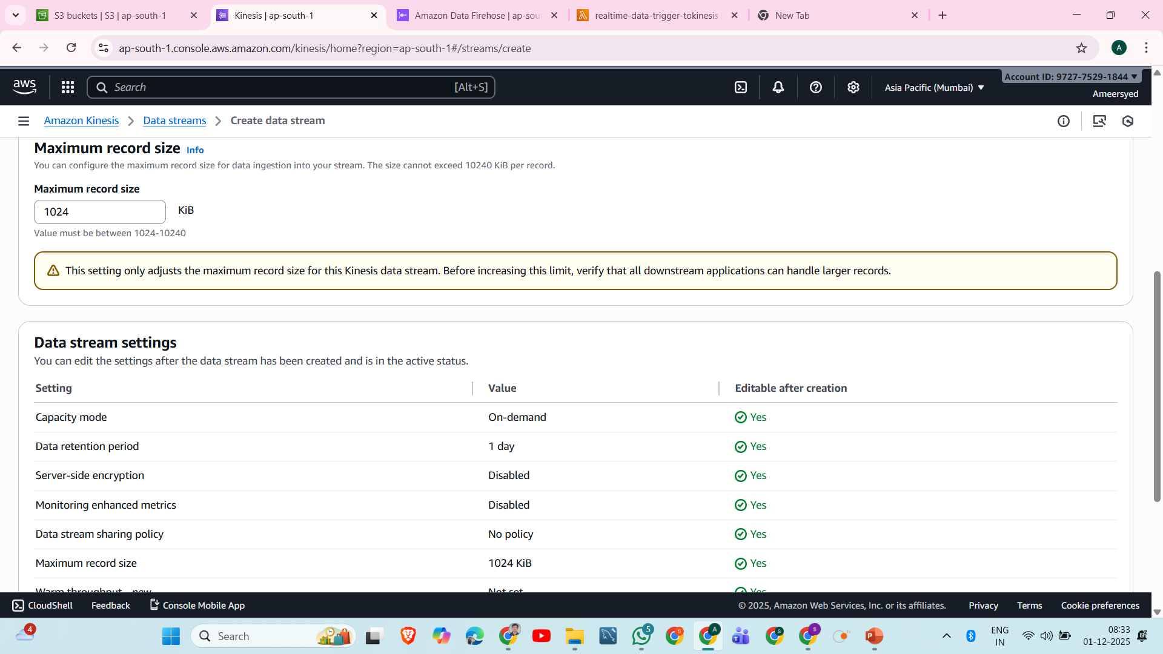

Slide 11
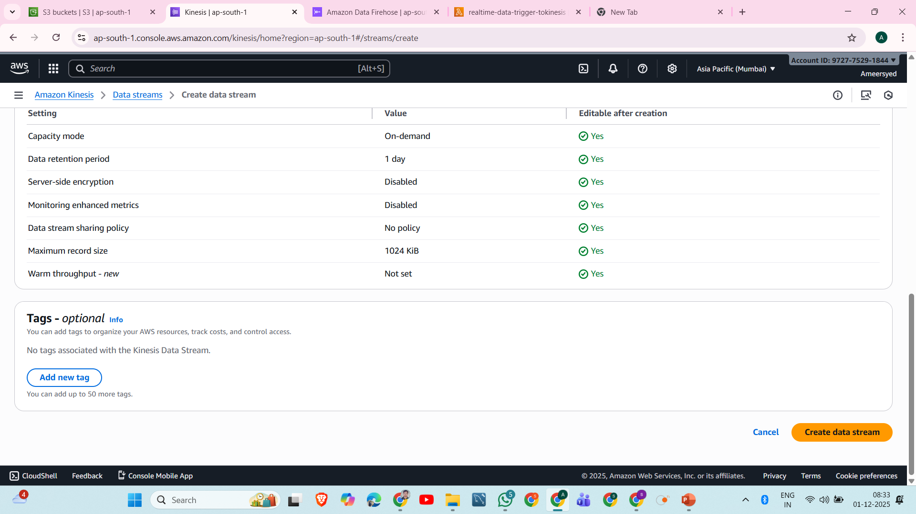

Slide 12
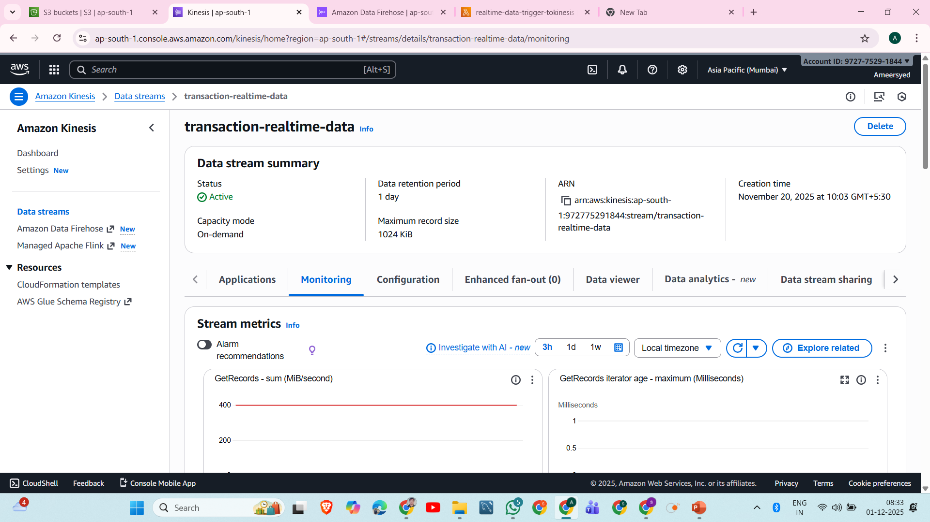

Slide 13
3. Create a Kinesis Firehose Delivery Stream
Purpose:
Firehose continuously reads data from Kinesis Stream
Delivers data into Final S3 Bucket
Steps:
Go to Kinesis → Firehose
Create delivery stream
Source: Kinesis Data Stream
Choose the stream created earlier
Destination: S3
Create/select final S3 bucket (e.g., output-realtime-data)
Set buffer:
Size: 1–5 MB
Interval: 1–60 seconds

Slide 14
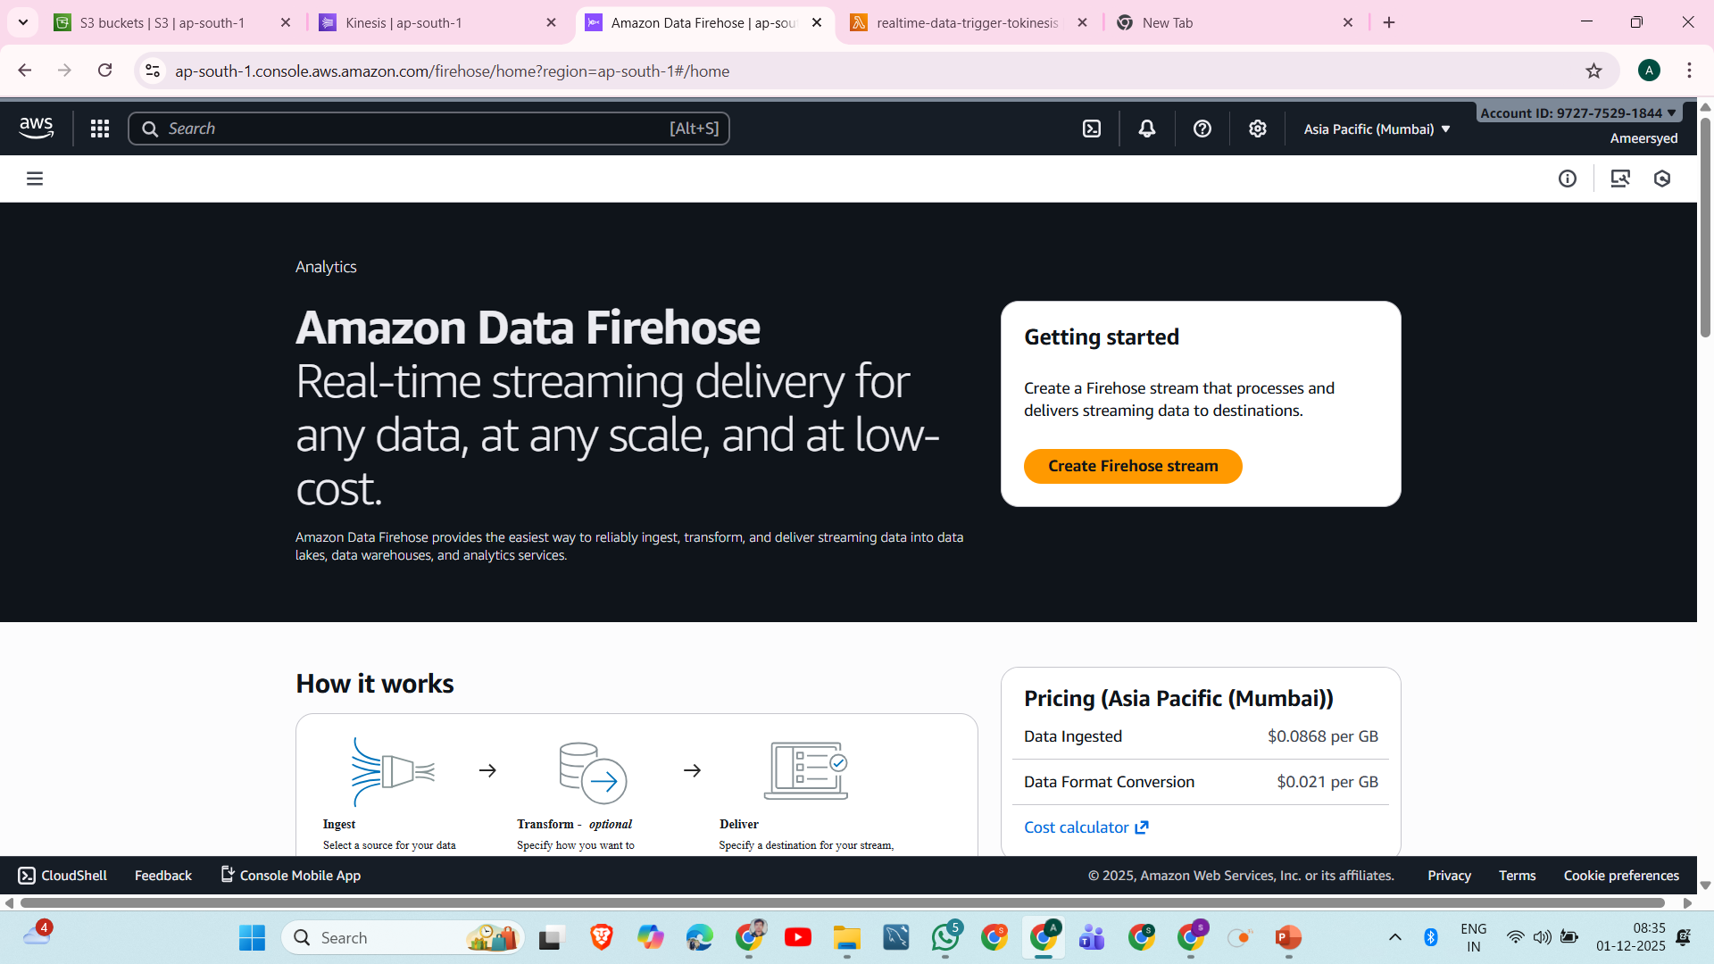

Slide 15
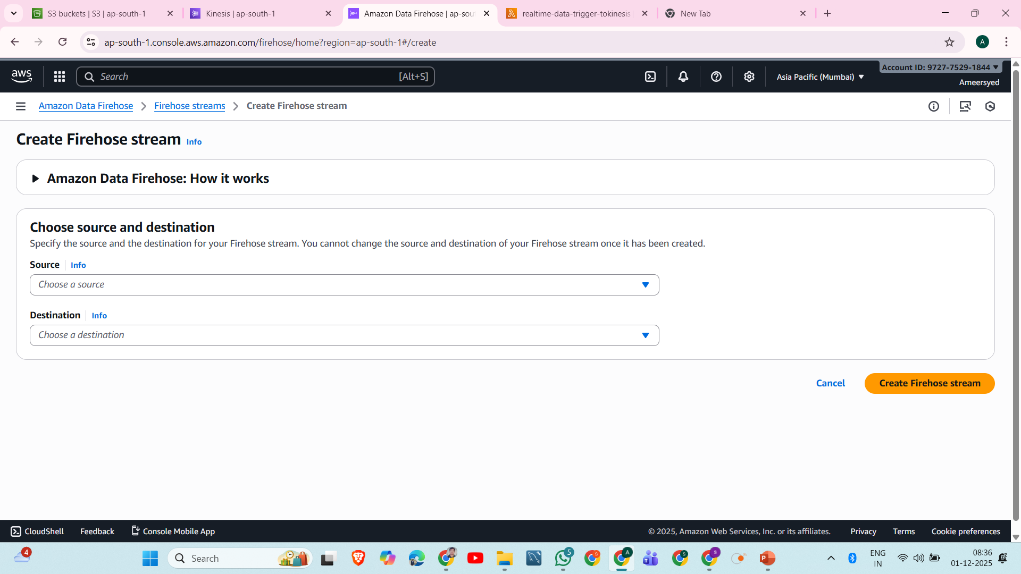

Slide 16
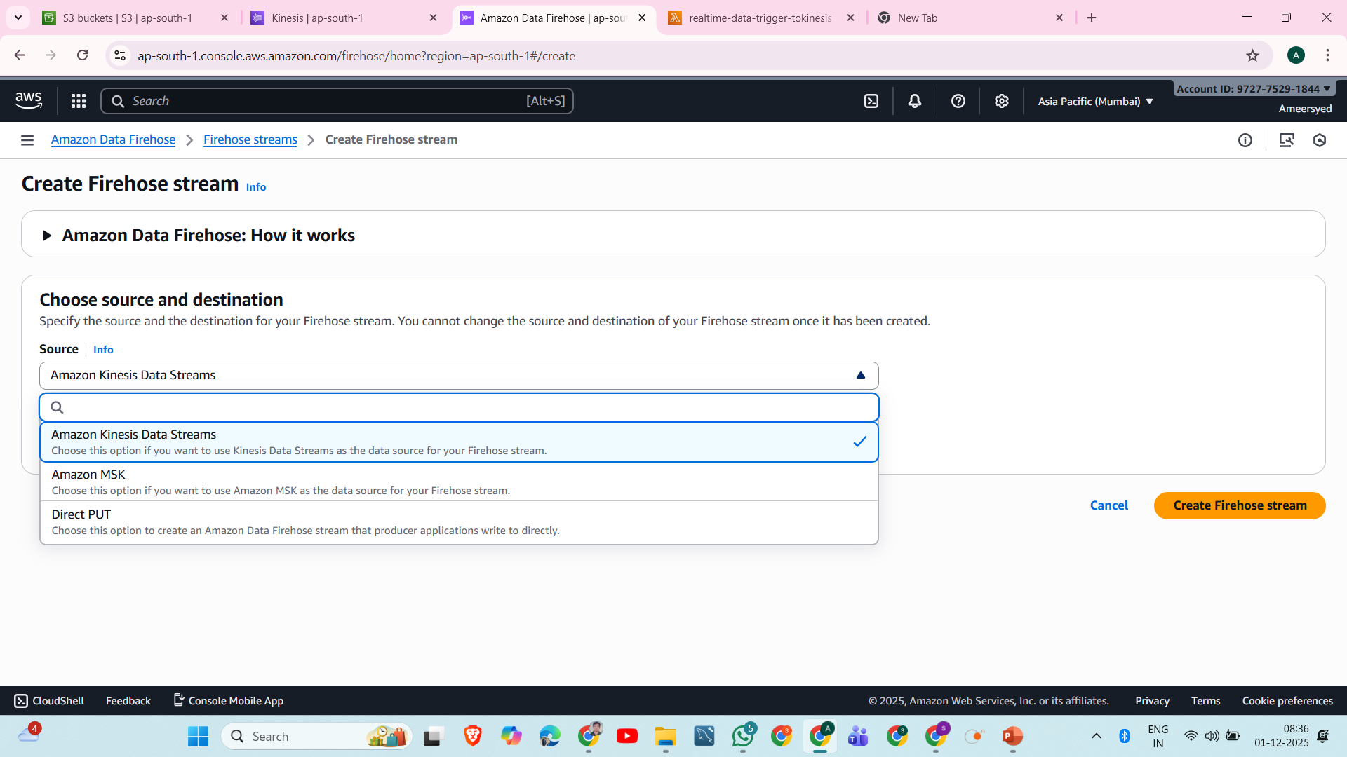

Slide 17
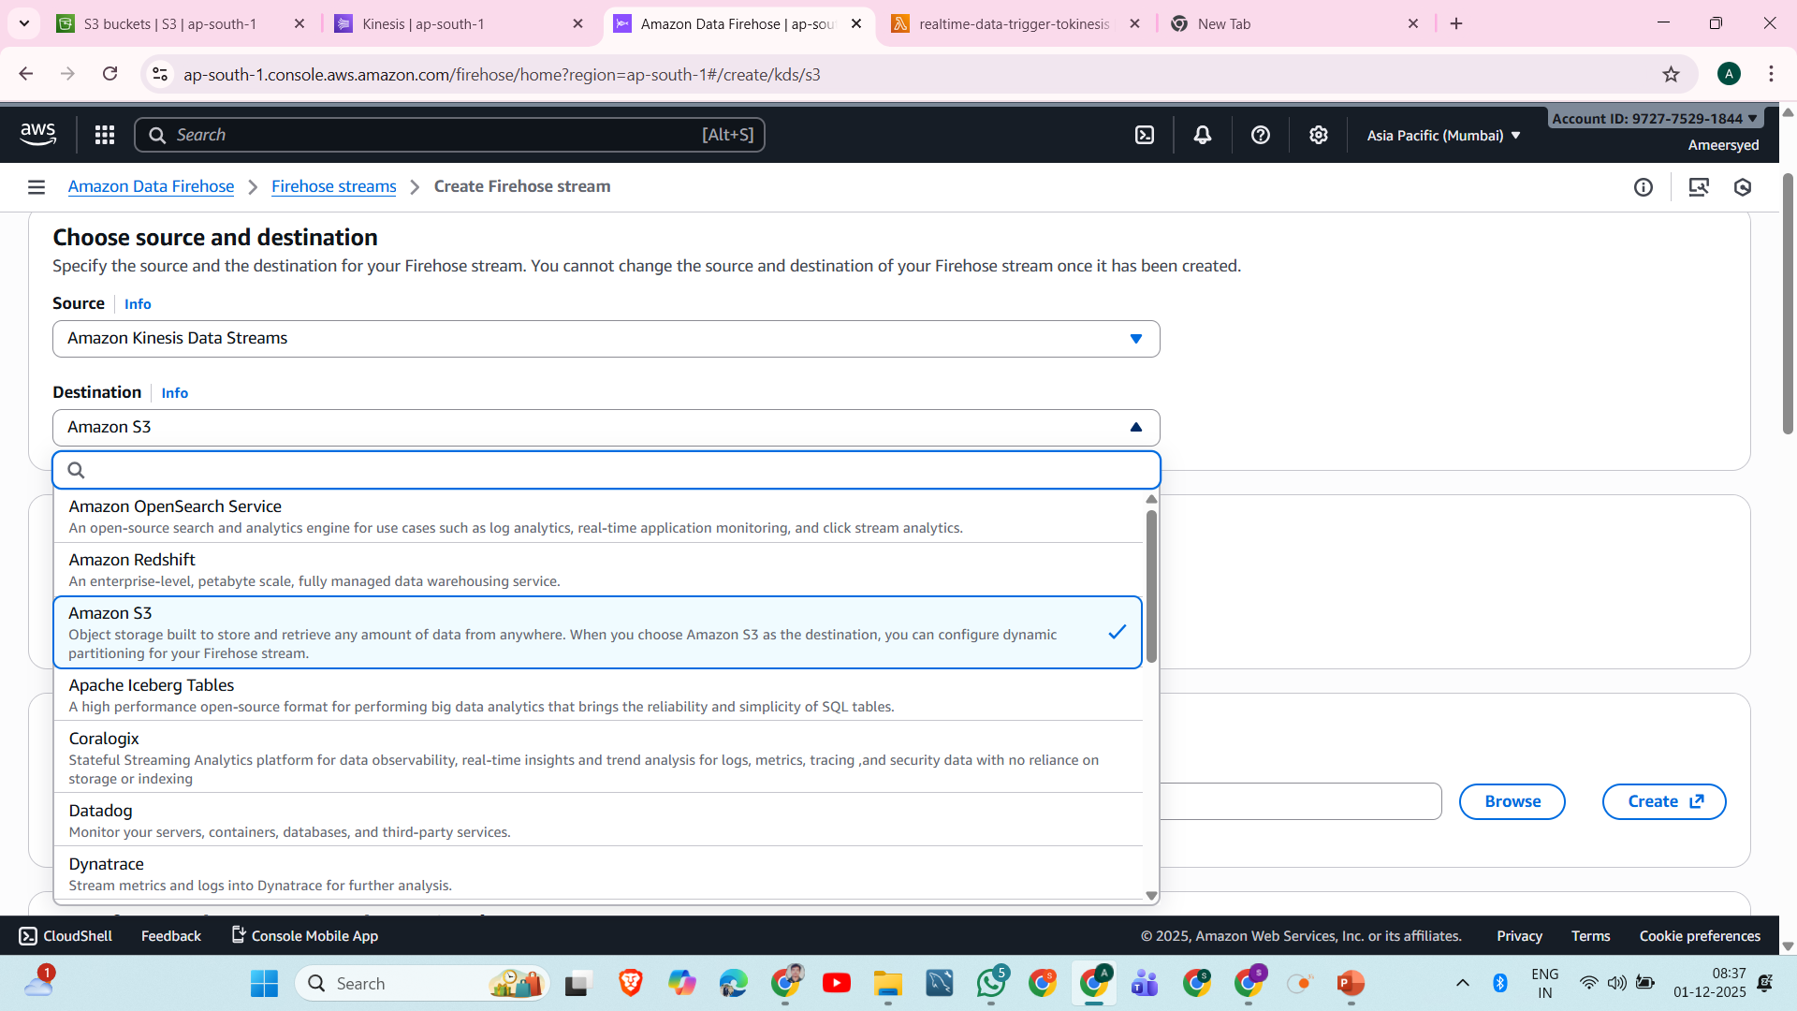

Slide 18
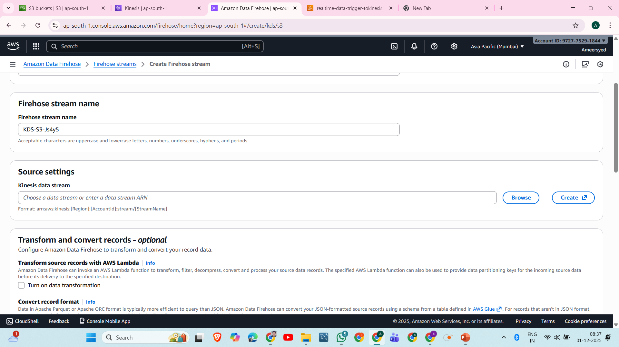

Slide 19
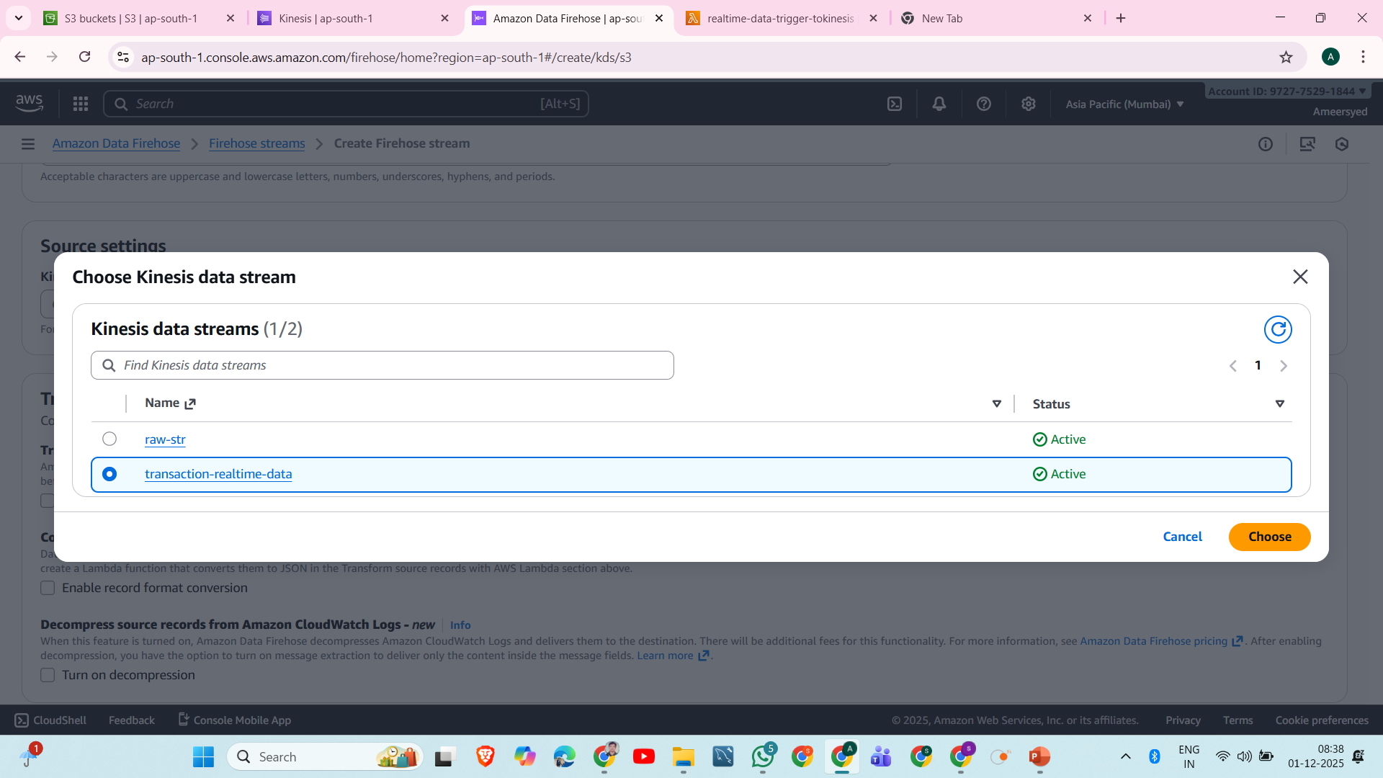

Slide 20
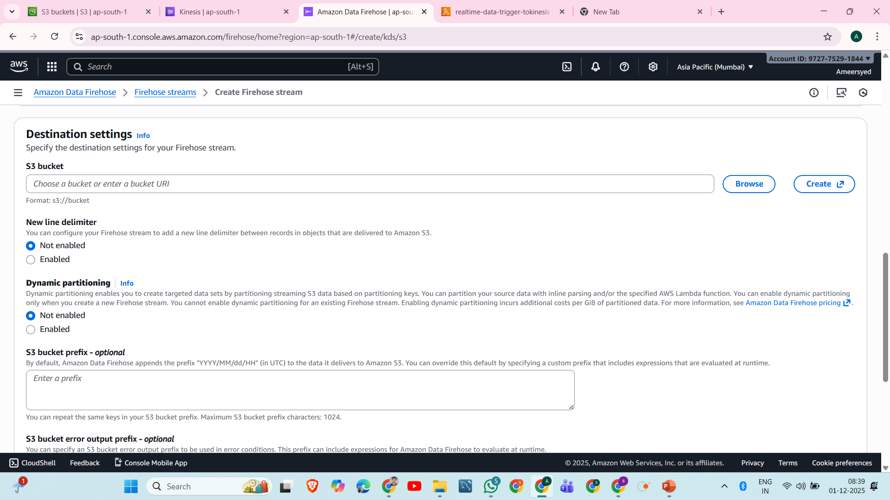

Slide 21
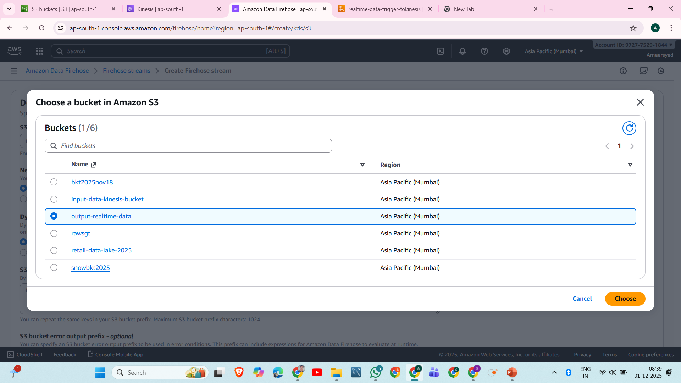

Slide 22
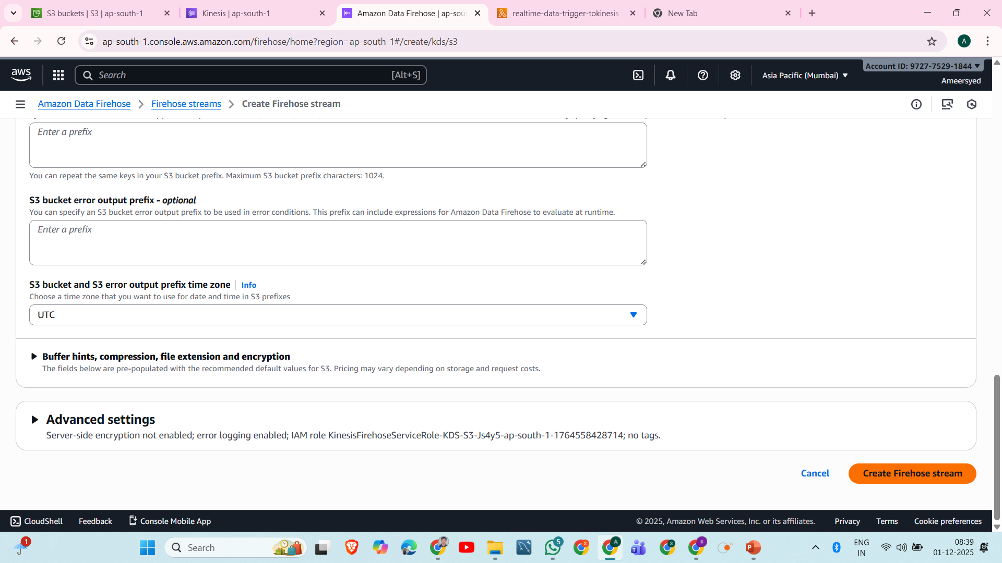

Slide 23
4. Create a Lambda Function
Purpose:
Triggered by S3 file upload
Reads file (or event metadata)
Processes it
Sends records to Kinesis Data Stream
Steps:
Go to AWS Lambda → Create function
Choose runtime (Python/Node.js)
Under Trigger, select S3
Choose PUT event

Slide 24
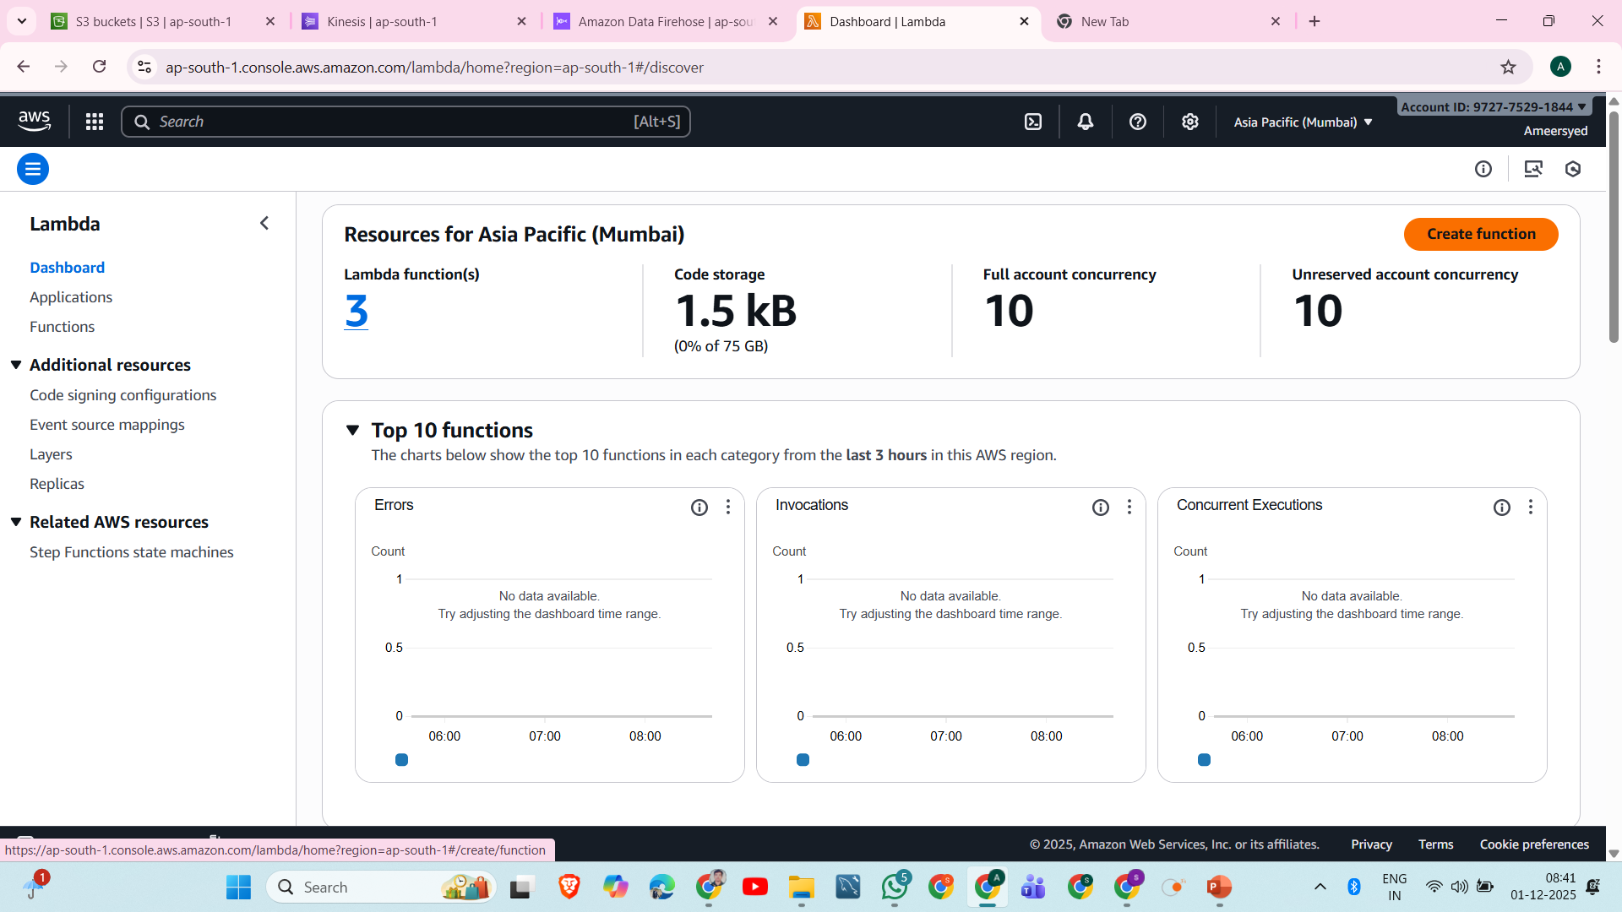

Slide 25
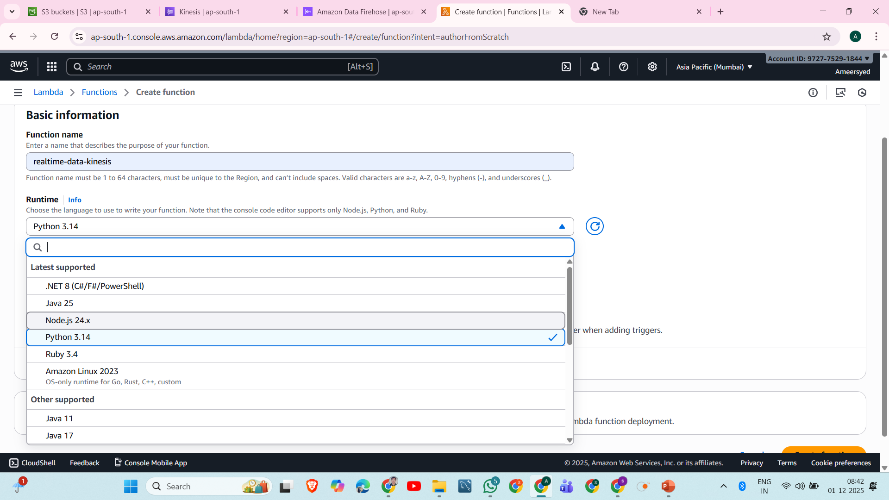

Slide 26
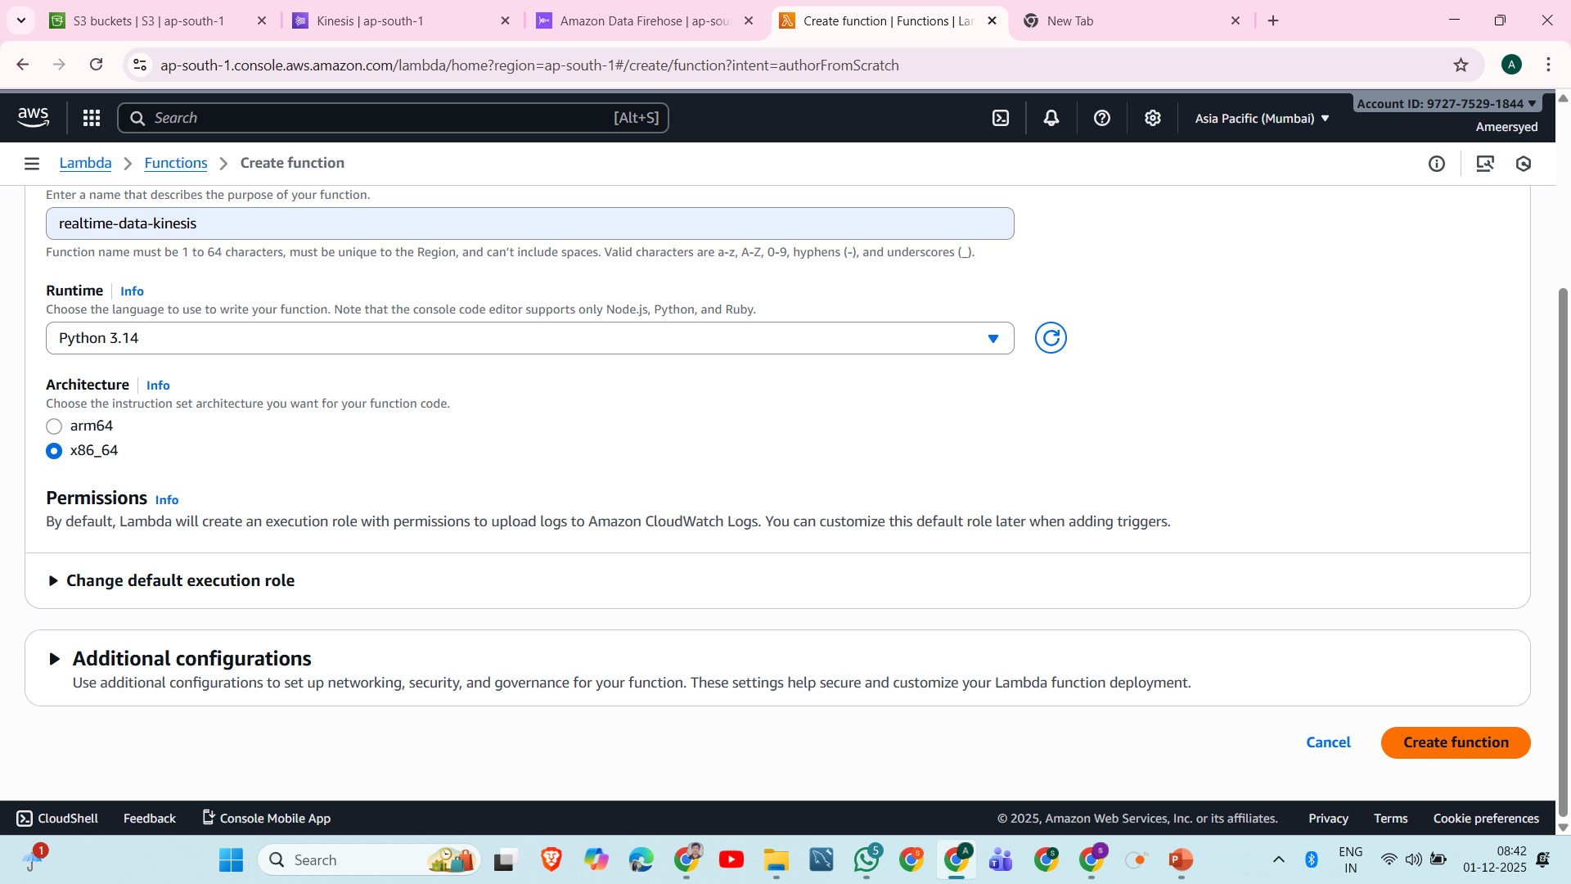

Slide 27
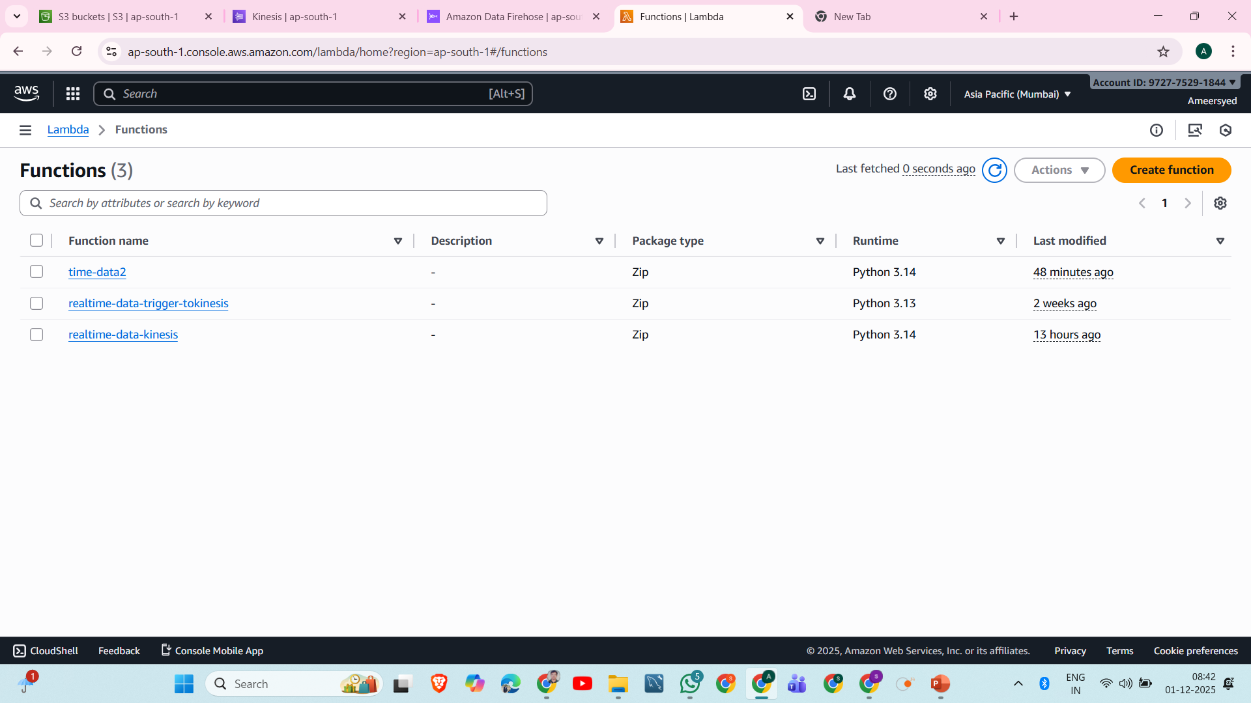

Slide 28
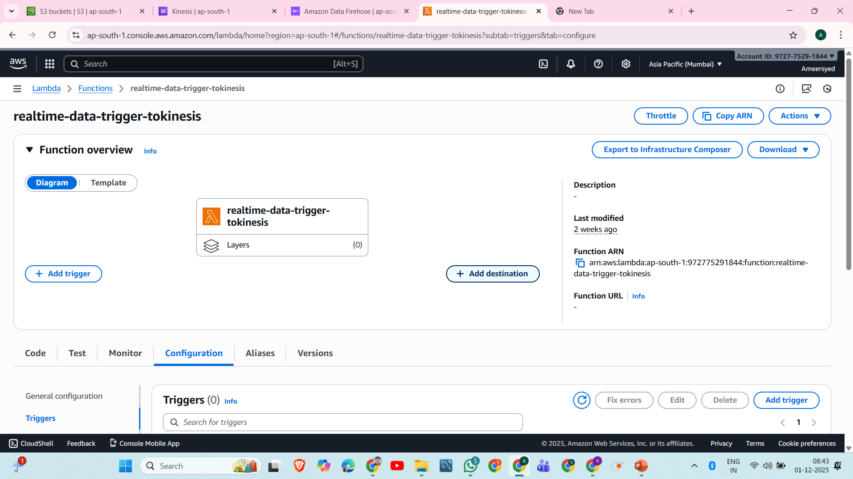

Slide 29
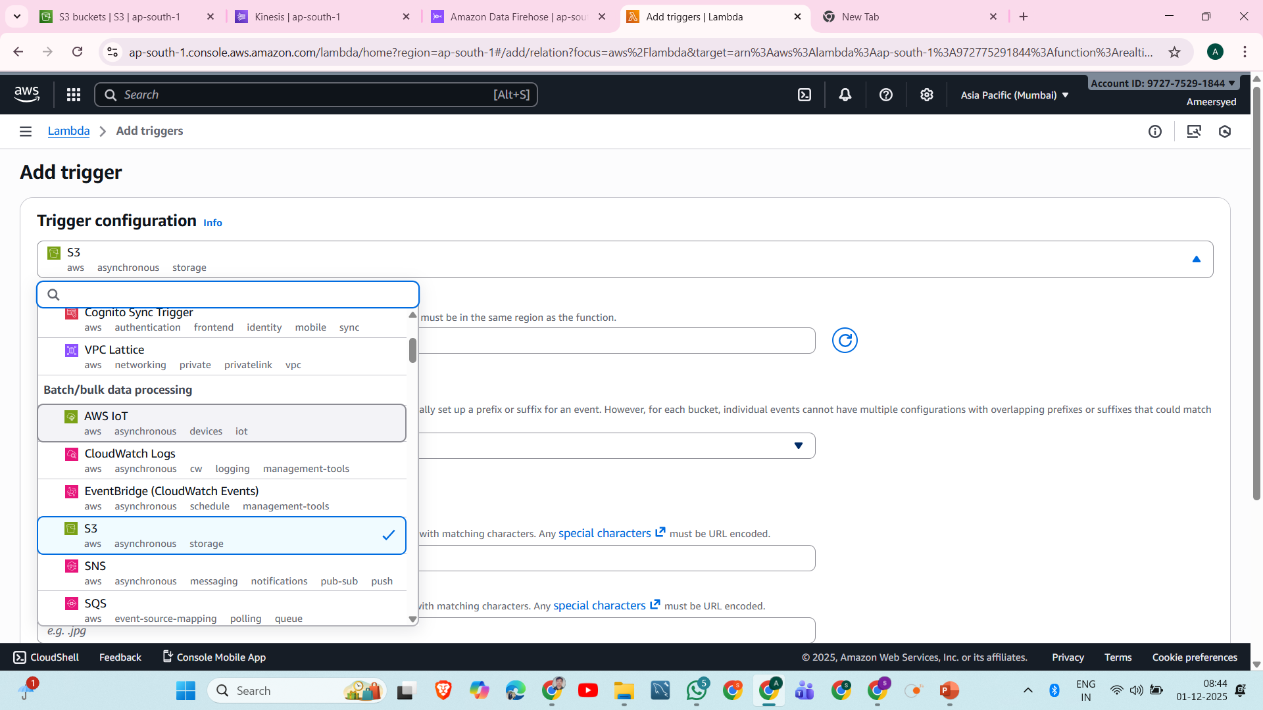

Slide 30
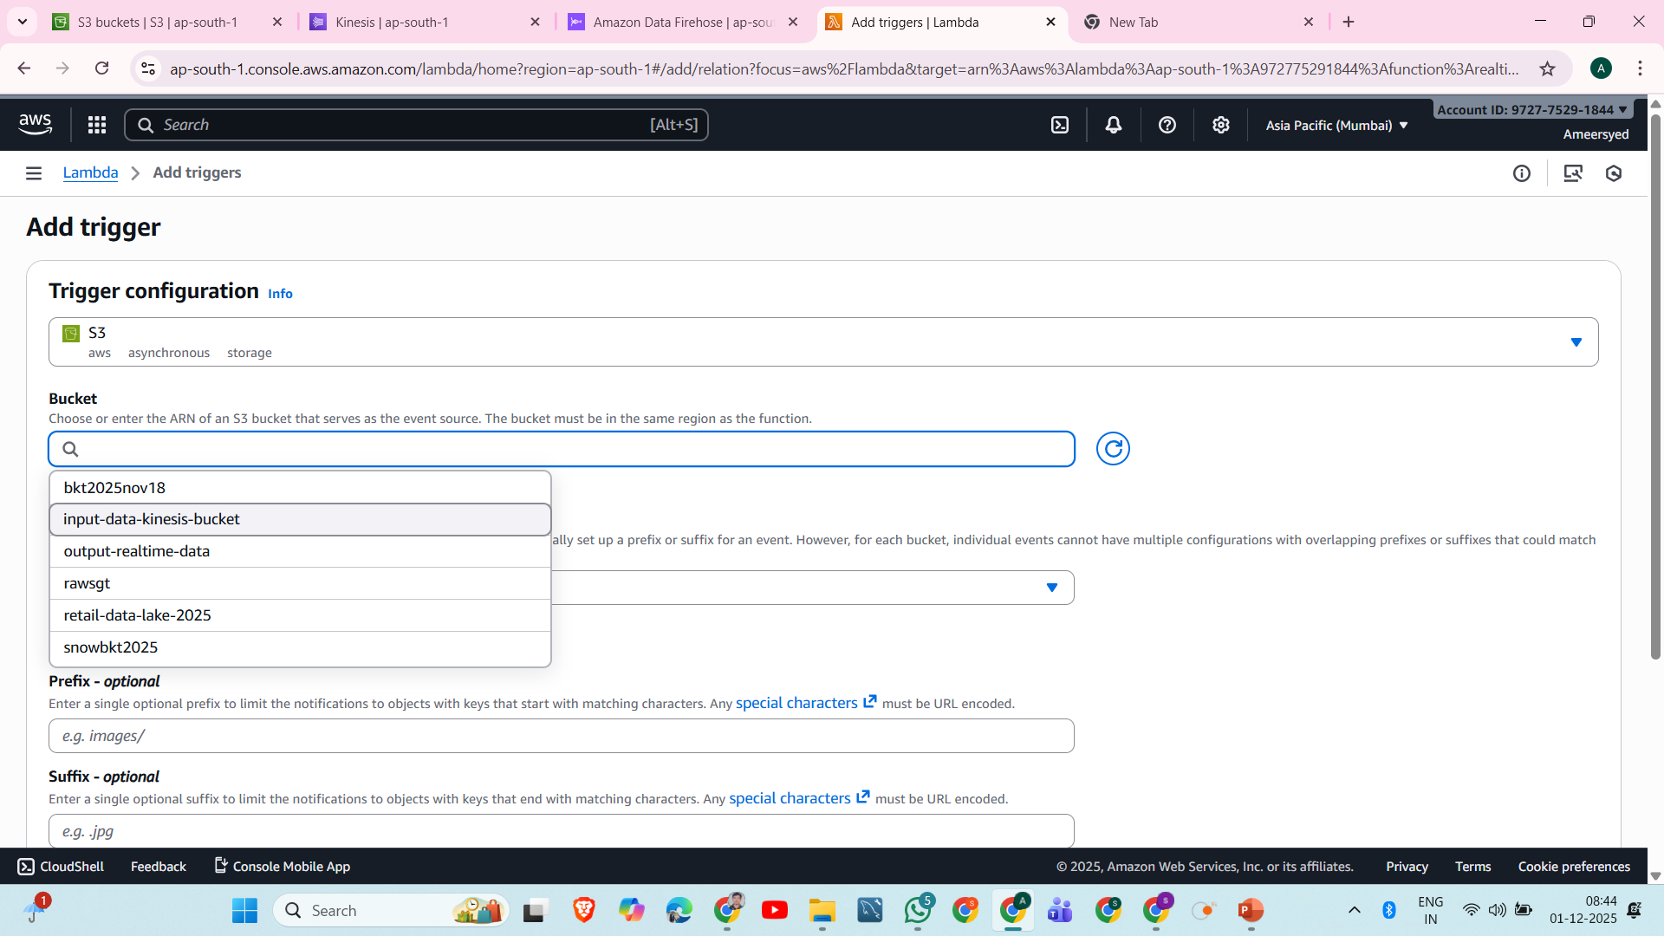

Slide 31
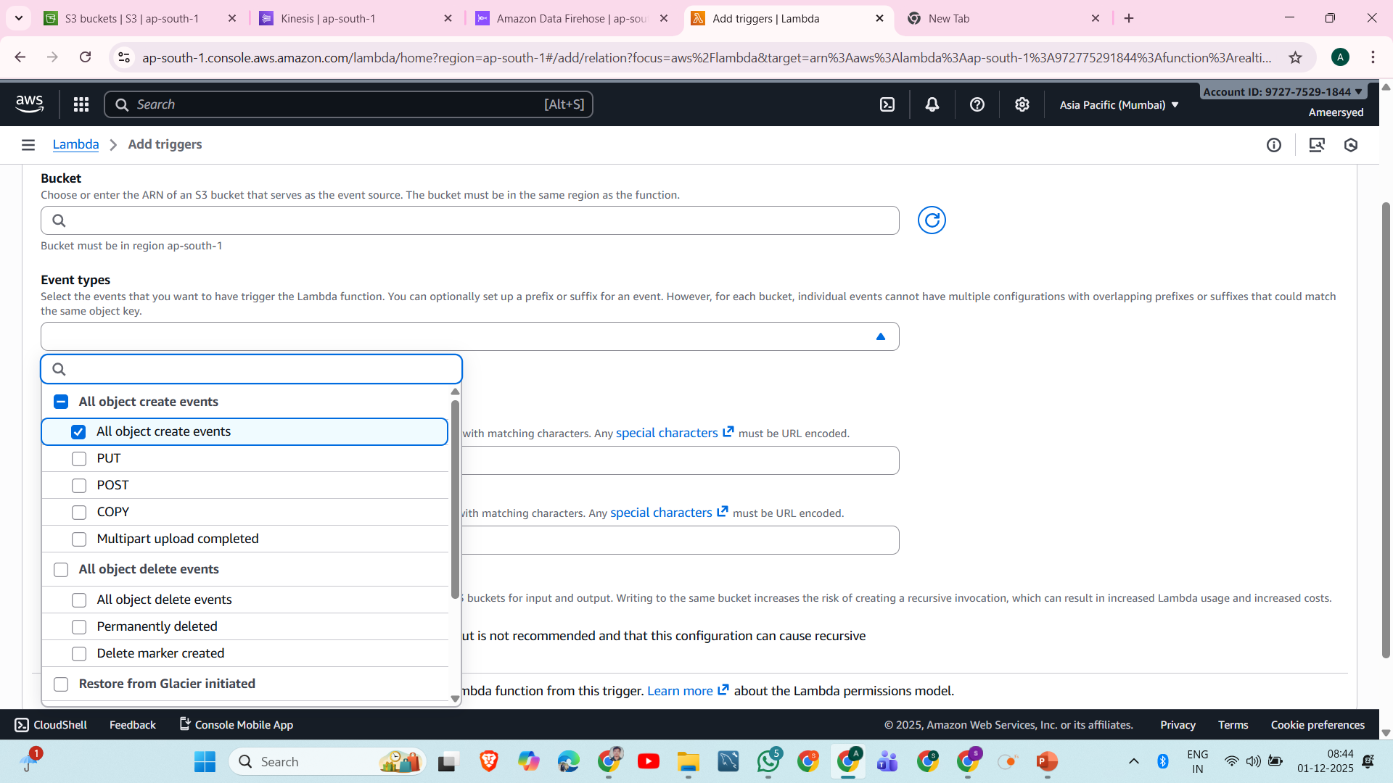

Slide 32
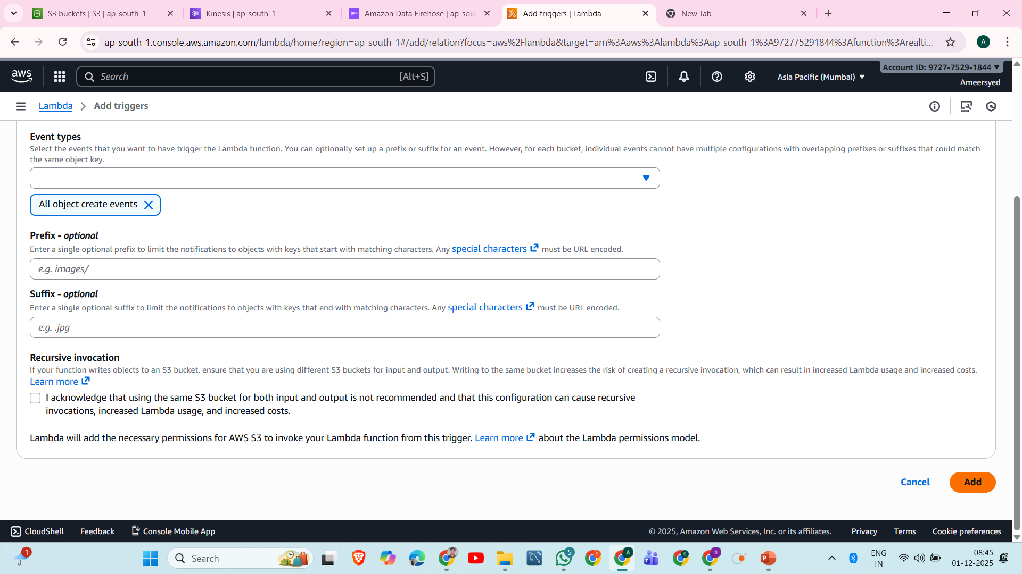

Slide 33
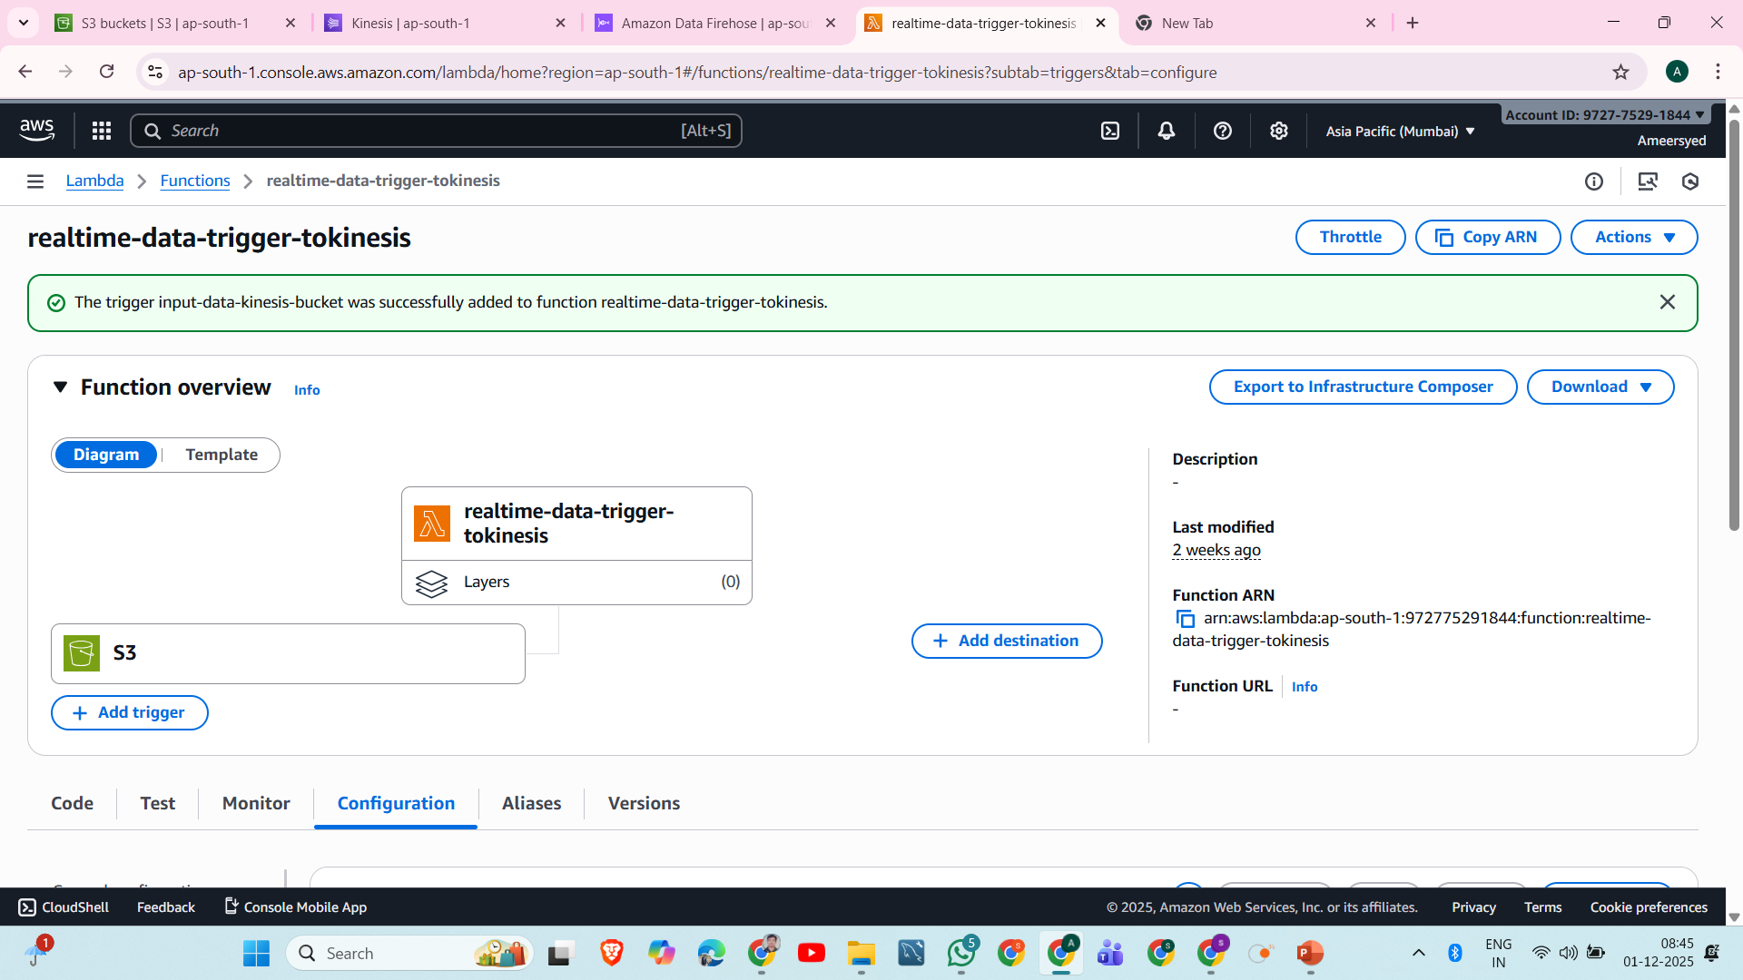

Slide 34
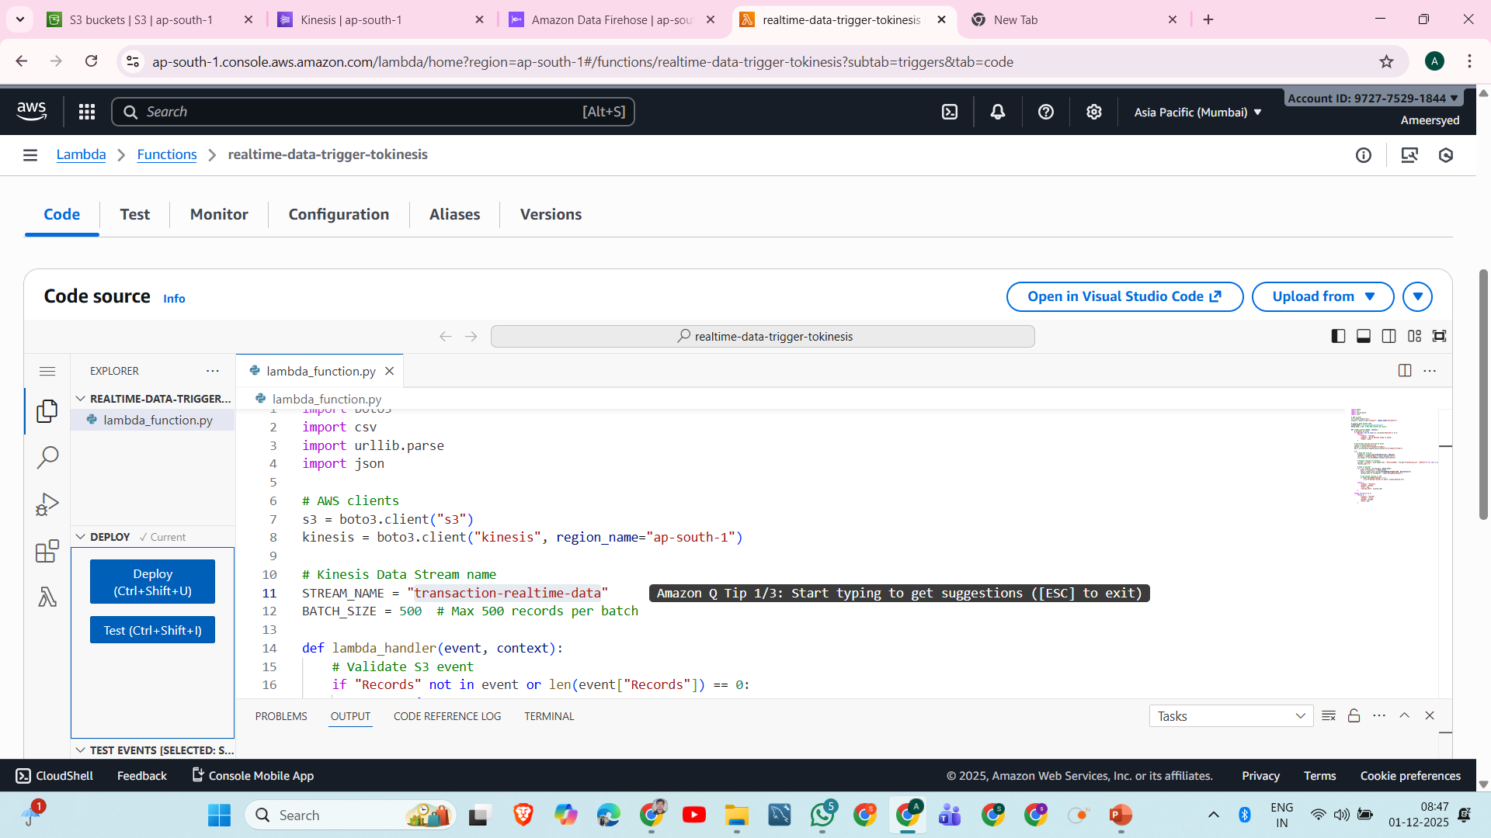

Slide 35
Example code (Python):
import boto3
import csv
import urllib.parse
import json
# AWS clients
s3 = boto3.client("s3")
kinesis = boto3.client("kinesis", region_name="ap-south-1")
# Kinesis Data Stream name
STREAM_NAME = "transaction-realtime-data"
BATCH_SIZE = 500 # Max 500 records per batch
def lambda_handler(event, context):
# Validate S3 event
if "Records" not in event or len(event["Records"]) == 0:
return {
"status": "Failed",
"reason": "No S3 Records found in event",
"event": event
}

Slide 36
# Get bucket and key from the S3 event
record = event["Records"][0]
bucket = record["s3"]["bucket"]["name"]
key = urllib.parse.unquote_plus(record["s3"]["object"]["key"])
try:
# Read CSV from S3
response = s3.get_object(Bucket=bucket, Key=key)
content = response["Body"].read().decode("utf-8")
csv_reader = csv.DictReader(content.splitlines())
# Prepare records for Kinesis
records = [{"Data": json.dumps(row), "PartitionKey": row.get("transaction_id", "default")} for row in csv_reader]
records_sent = 0
# Send in batches
for i in range(0, len(records), BATCH_SIZE):
batch = records[i:i + BATCH_SIZE]
resp = kinesis.put_records(StreamName=STREAM_NAME, Records=batch)
records_sent += len(batch) - resp['FailedRecordCount']
# Log failed records if any
if resp['FailedRecordCount'] > 0:
print(f"Failed records in batch: {resp['Records']}")
return {
"status": "Success",
"bucket": bucket,
"file": key,
"records_sent": records_sent
}

Slide 37
return {
"status": "Success",
"bucket": bucket,
"file": key,
"records_sent": records_sent
}
except Exception as e:
return {
"status": "Failed",
"reason": str(e),
"bucket": bucket,
"file": key
}

Slide 38
5. IAM Permissions Required
Lambda must have:
Read from S3
Write to Kinesis Data Stream
Firehose must have:
Read from Kinesis Stream
Write to final S3 bucket
AWS automatically creates the Firehose role if you allow it.

Slide 39
After lambda processing, data has been sent to AWS kinesis data stream , check your data showing below

Slide 40
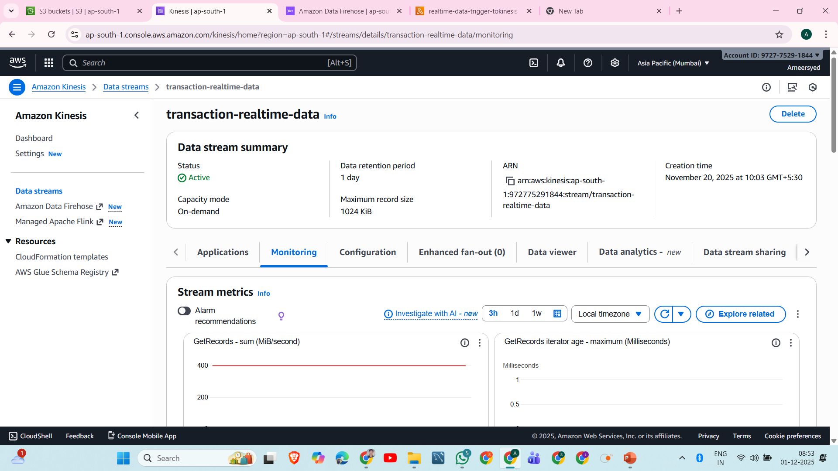

Slide 41
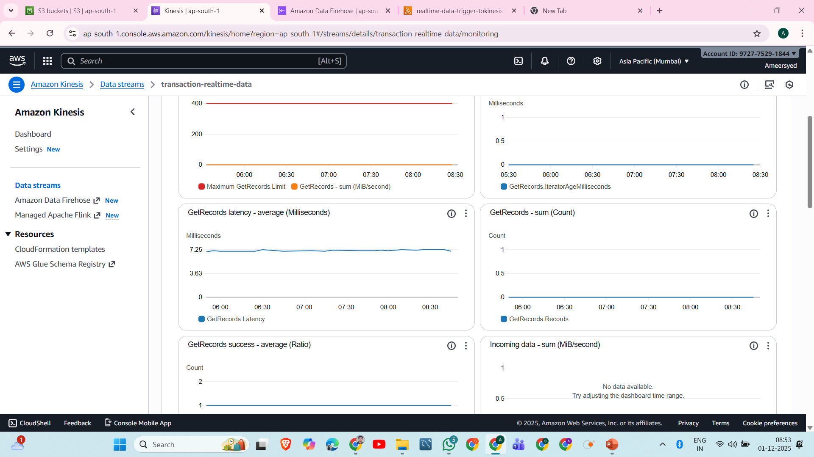

Slide 42
After aws kinesis data stream, data has been sent to AWS firehouse data stream , check your data showing below

Slide 43
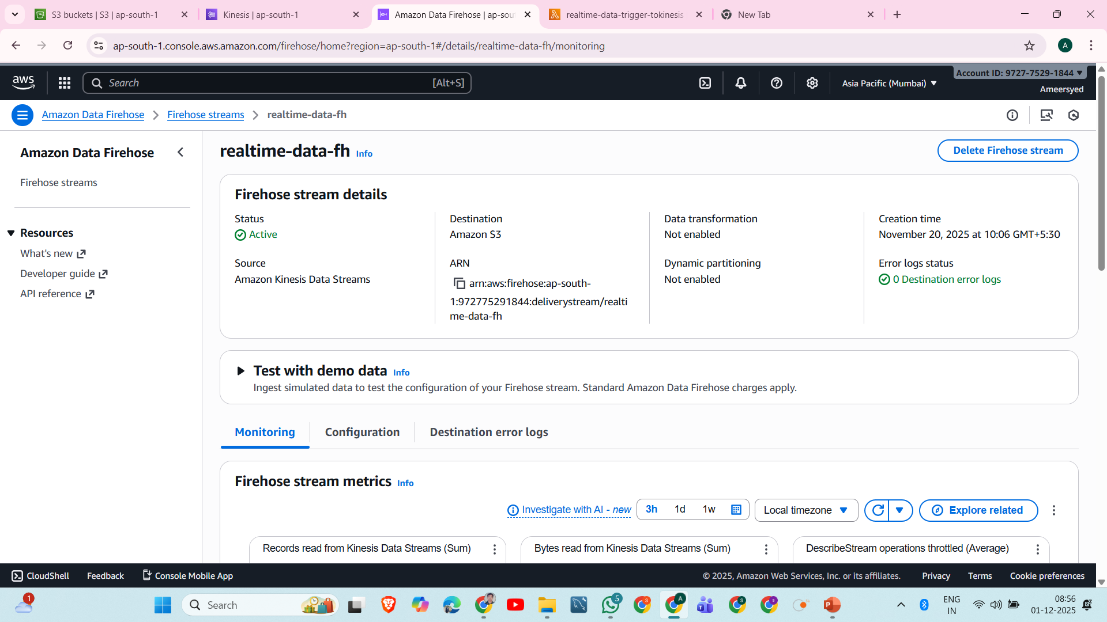

Slide 44
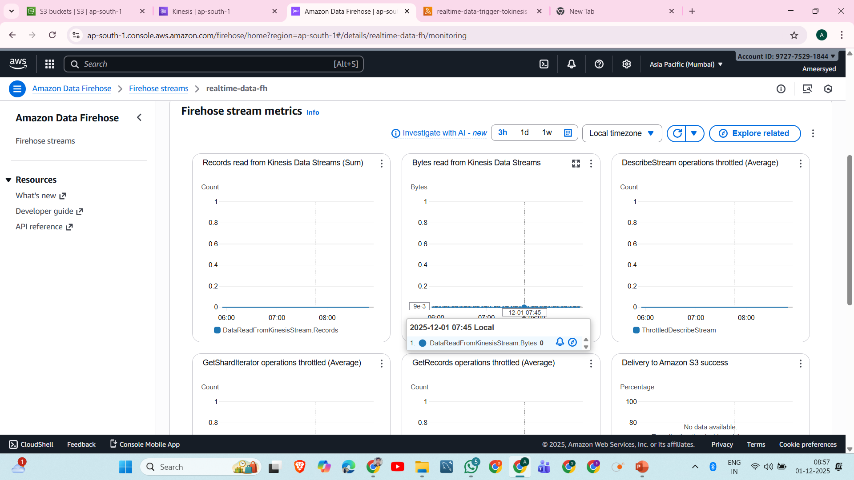

Slide 45
After all processing has been done then streaming data sent to destination of s3.

Slide 46
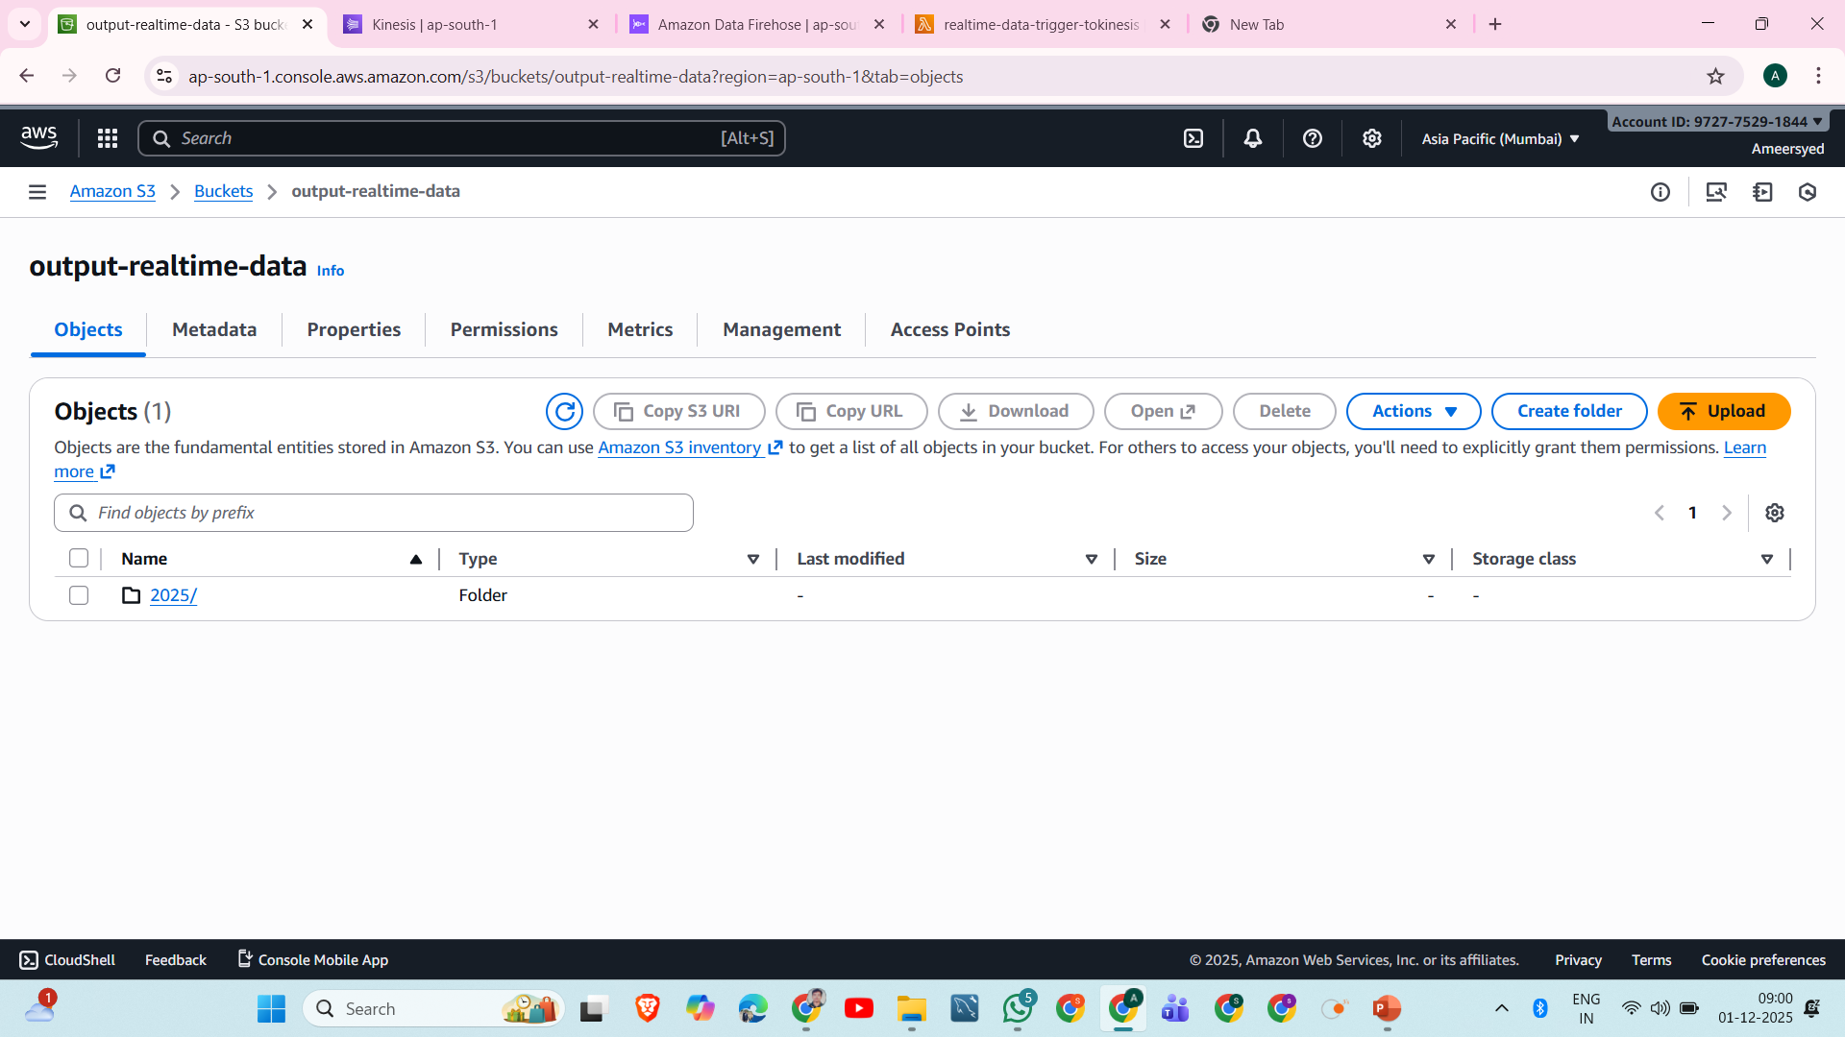

Slide 47
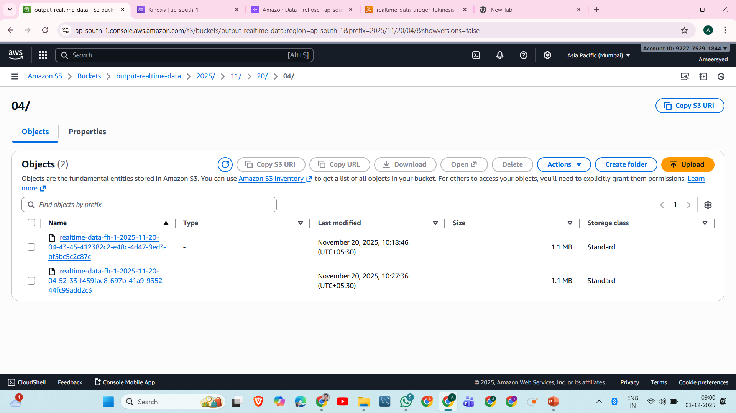

Slide 48
Thank You

